Slide 1
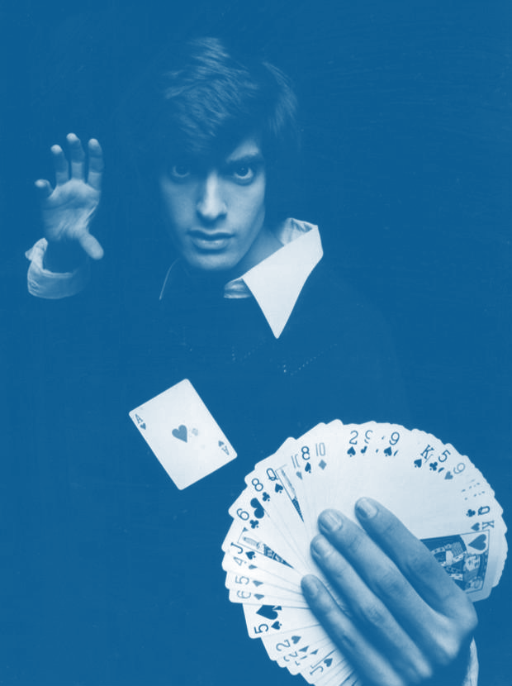
Powerful Funder Partnerships!
Community impact its not a magic trick.
Creating a collaborative mindset with funders on solving complex problems is a must if the funder, organization and community is to succeed.
PMG
Notes:
To use this title animation slide with a new image simply 1) move the top semi-transparent shape to the side, 2) delete placeholder image,
3) click on the picture icon to add a new picture, 4) Move semi-transparent shape back to original position, 5) Update text on slide.

Slide 2
INTRODUCTIONS
Who is PMG……
  Consultants that promote Community Collaboration, Design & Develop Community Impact Plans and Coach Collectives through the formation and implementation of collective impact models.
Today we will:
Discuss barriers to funder engagement…..
Understand how to shift the narrative…..
Design next steps to help operationalize funder/ partner engagement…..
This will be…..
Shared dialogue of learning
We will work within this room and practice that which we seek to produce outside of it.
Lets get started……..who are you and one thing you are personally passionate about?

Slide 3

Howard Schultz — American Businessman born on July 19, 1953,
Howard D. Schultz is an American businessman. He is best known as the chairman and CEO of Starbucks and a former owner of the Seattle SuperSonics. He was a member of the Board of Directors at Square, Inc. In 1998, Schultz co-founded Maveron, an investment group, with Dan Levitan. In 2012, Forbes magazine ranked Schultz as the 354th richest person in the United States, with a net worth of $1.5 billion... (wikipedia)
Great companies that build an enduring brand have an emotional relationship with customers that has no barrier. And that emotional relationship is on the most important characteristic, which is trust. Howard Schultz
—

Slide 4
Excuses
What keeps us from funder engagement?
Small group discussion……
If they really knew …..
They don’t understand …….
I am so tired….

Slide 5
What are some of the effects of lack of understanding?
How does it feel?
What do you think?
What do you do?

Slide 6





Do you know your funders?

Slide 7
Hearts over heads
Many people are also aware that they should donate to the causes that have the highest impact, but facts and figures are less attractive than narratives.
In a series of experiments, it was found that people are much more responsive to charitable pleas that feature a single, identifiable
beneficiary, than they are to statistical information about the scale of the problem being faced.
Further work also discovered that advertising which emphasis the proven effectiveness of the charity does not increase giving.
Other evidence suggests that the effect of this information can actually be the opposite.
In short, when it comes to charitable giving, we are often ruled by our hearts and not our heads.
Influenced by others
Another of the major takeaways from the research in this area is that giving is fundamentally a social act.
One study shows that people give significantly more to their university if the person calling and asking for their donation is their former roommate.
Researchers found that when JustGiving donors see that the donor before them has made a large donation, they make a larger donation themselves.
It’s not just out friends and families who can influence us. Donors to an international development charity
were more likely to respond to a match–funding campaign if they knew that that the match came from the Bill and Melinda Gates foundation
than if it came from an anonymous source. In our own research working with a large employer and Marie Curie, we have found that celebrity
supporters increase donations to charity, and fast – but that this only appears to work for people who have donated to the charity before.
Giving is contagious
The good news is that charitable giving is contagious – seeing others give makes an individual more likely to give
and gentle encouragement from a prominent person in your life can make also make a big difference to your donation decisions –
more than quadrupling them in our recent study. Habit also plays a part – in three recent experiments those who volunteered before were more
likely to donate their time than those who had not volunteered before.
Assumptions
  Why do people or organizations give?
!

Slide 8
How do I set the STAGE and provide a path
go ahead and follow the basic 5 steps
1
2
3
4
5
Understand
your brand
and your audience; speak authentically
Gauge interest in when and how to begin a relationship
Ask important questions…..
Be transparent
Be honest…….
Show,
don’t just tell
Bring them into your arena…..
Understand theirs…..
Create the path together ….

Slide 9
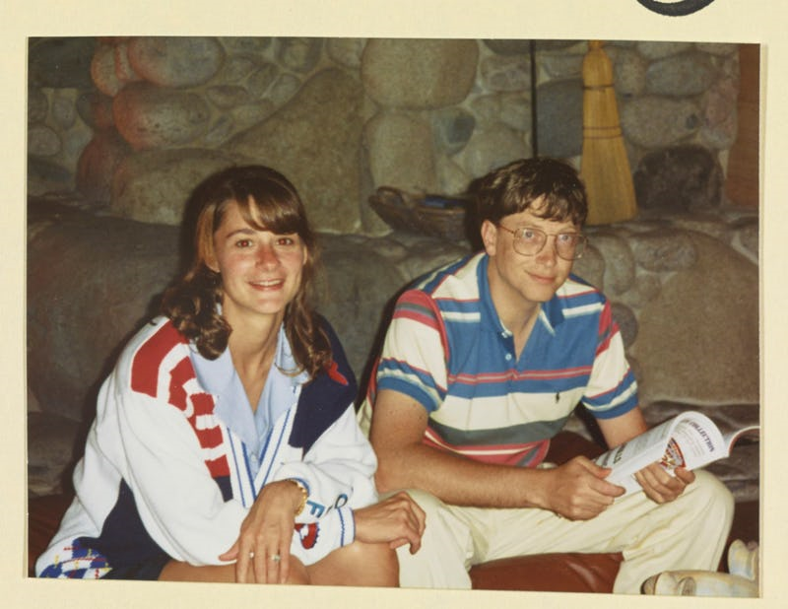
People own what they helped to create!
FACT
https://www.dallasnews.com/business/philanthropy/2018/03/16/dallas-homegrown-melinda-gates-opens-important-speak-now

Slide 10


1
Understand your brand
and audience; speak in
an authentic voice
PREPARE
    Why does this matter to your audience?
      Where are you taking them?

Slide 11

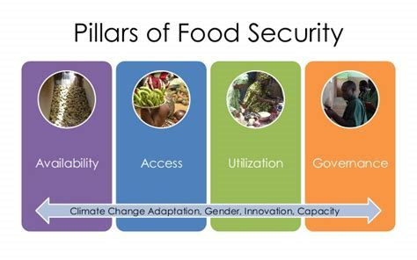
2
Is your funder-Partner open to engagement?
Grant due March 22…………..When should we have started a relationship?
How do we get started
Who-What-How

Slide 12

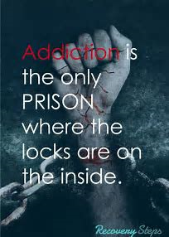
3
Get your facts straight
with 5 W’s
DEFINE TOGETHER
    Who | What | Where | When | Why

Slide 13
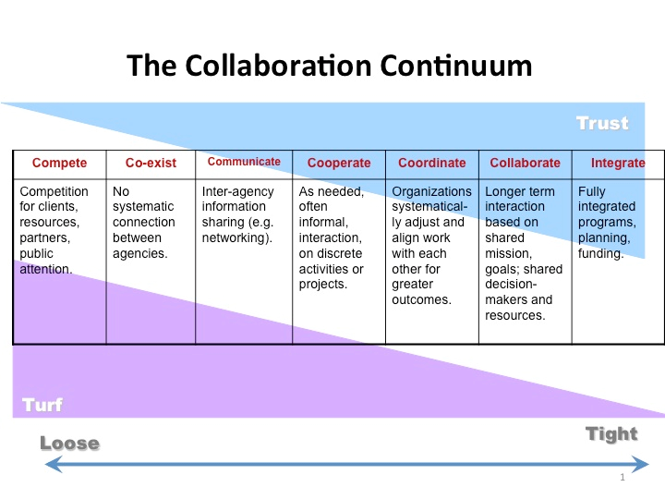
Pick one funder then one partner you currently have mid-high trust with and share what that is like……

Slide 14
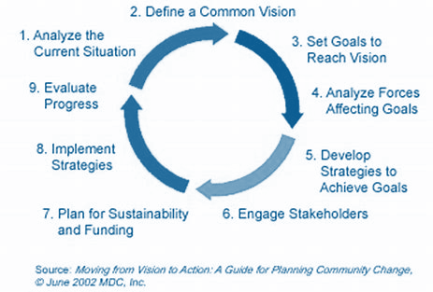
4
Show, don’t tell
ENGAGE
      Now we know why it matters to each of us what do we want to do together?
      Expand Engagement
      Link to other work funder is doing and partners expand your circle of influence.

Slide 15
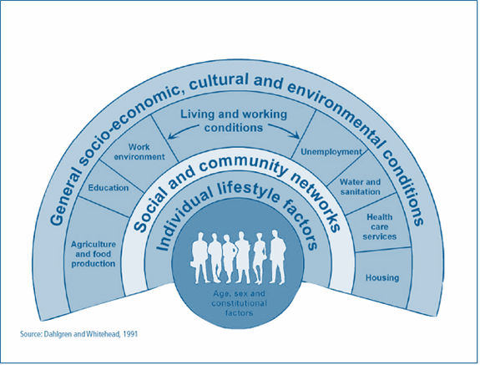





5
Know the end
at the beginning
LEAD Together
Shared Vision
Shared Planning
Shared Outcomes

Slide 16
STORYTELLING ,
AND VISUAL STORYTELLING,
WAS PUT IN THE HANDS OF EVERYBODY,
  WE HAVE ALL NOW BECOME STORYTELLERS.
—LEVAR BURTON

Slide 17
POWERFUL FUNDER PARTNERSHIPS!
THANK YOU

